Slide 1








IEEE, KSV
STUDENT BRANCH
Track Number:2
Track Title: Safe ,Trusted & Responsible Technology
PROBLEM STATEMENT:
Industrial motors often fail unexpectedly due to issues like voltage drops, abnormal vibrations, overheating, or reduced RPM. These unplanned failures lead to costly downtime, safety risks, and reduced productivity. There is a need for a smart, real-time motor monitoring system that can automatically sense performance deviations, detect early signs of faults, and accurately predict motor failure before it occurs.
Team ID:ID_25_INFRA-NEX
Team Name: INFRA-NEX
Institute Name: LDRP-ITR

Slide 2





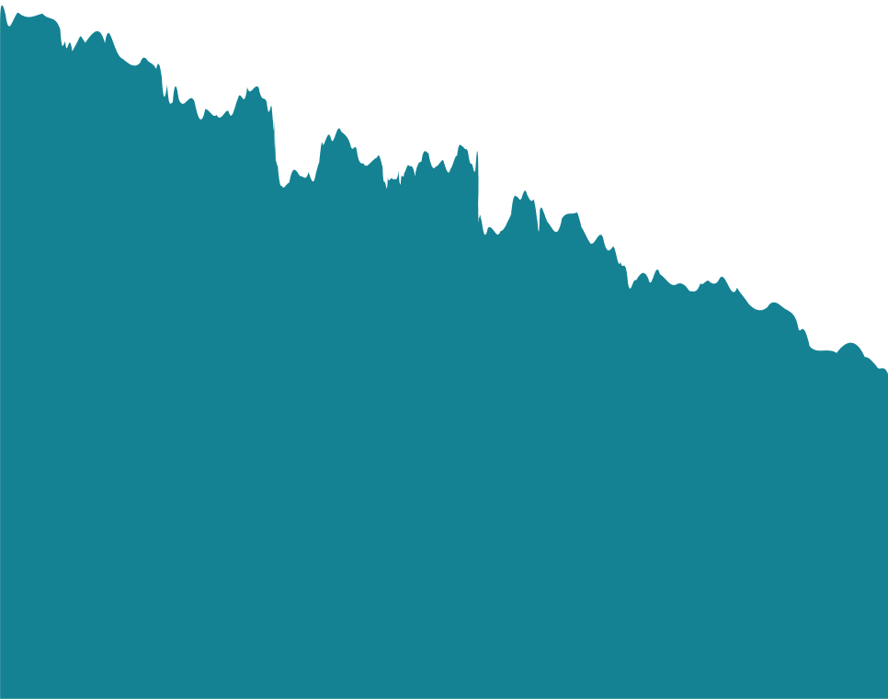
TEAM DETAILS
VACHHANI PRAZAL KAUSHIKBHAI
PATEL RAJVI ASHVINKUMAR
HADIYA PRIYANK NAVIN
THAKKAR PANKTI ATULKUMAR
PROF.NIKHILKUMAR H. PATEL
Team Leader
Co-Team Leader
Team Member
Team Member
Guide
24BEEC30050
BE-EC, LDRP-ITR,
KSV
24BEEC30032
BE-EC, LDRP-ITR,
KSV
24BEEC30007
BE-EC, LDRP-ITR,
KSV
24BEEC30049
BE-EC, LDRP-ITR,
KSV
EC DEPARTMENT, LDRP-ITR,
KSV
2

Slide 3

IDEA DETAILS
Clear explanation of the idea and how the solution works:
Unique features and innovative elements compared to existing options:
A smart IoT-based motor health monitoring system continuously tracks motor condition using six sensors—current, voltage, stator and bearing temperature, vibration, and RPM. An ESP32 processes and correlates all sensor data in real time to analyze trends and detect early fault patterns such as overheating, overload, misalignment and bearing failure with high accuracy. The data is sent to a cloud dashboard via Wi‑Fi/MQTT for real-time visualization, alerts, and automatic shutdown, enabling predictive maintenance and reducing unexpected failures and downtime.
Feature | Existing Solutions | Our Solution
Sensors used | 1–2 basic sensors | 6 correlated sensors (current, temp, vibration, RPM, voltage)
Fault detection logic | Simple threshold checks | Multi-parameter correlation + trends
Warning time | 0 min (after failure starts) | 5–10 min early warning
Output | Generic “ALARM” | Specific fault type + priority level
Accuracy & false alarms | 40–50% accuracy, many false alarms | 70–99% accuracy, low false alarms
Connectivity & scalability | Local only, few motors | Cloud-based, scalable to 100+ motors
How the solution effectively solves the problem:
Our system replaces blind, single-sensor alarms with an always-on intelligent “motor doctor.” It
continuously monitors six motor parameters together to build a complete health profile and correlates them in real time.
Analyzes trends, predicts failures 5–10 minutes in advance,
accurately identifies the fault type, and can automatically shut down the motor when needed—preventing damage, reducing downtime,
enables planned maintenance instead of sudden breakdowns.
.
3

Slide 4
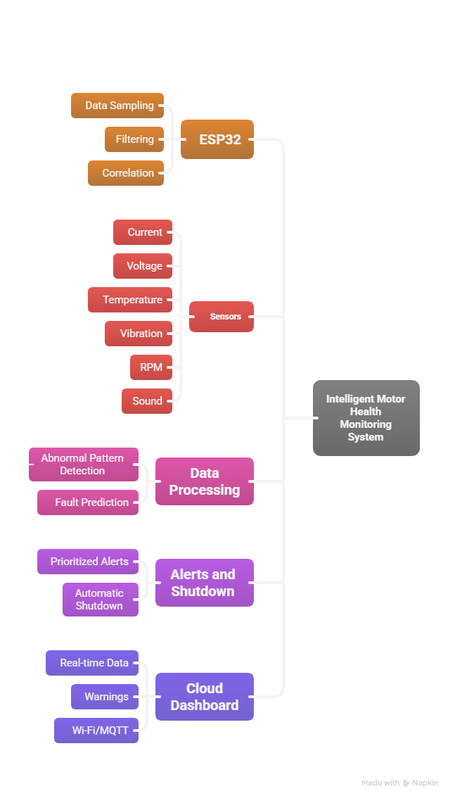
TECHNICAL APPROACH
List of technologies to be used:
Methodology for implementation:
Step-by-Step Methodology
1.Sensor Interfacing & Calibration
Interface all six sensors with the ESP32 and calibrate them to ensure accurate current, voltage, temperature, vibration, and RPM measurements.
2.Real-Time Data Acquisition
Collect sensor data at 1 sample per second, convert raw values into engineering units, and timestamp each reading.
3.Data Processing & Fault Detection
Apply filtering to remove noise, correlate multi-sensor data, identify fault patterns, and assign priority levels (warning/critical).
4.Cloud Communication
Transmit real-time data and alerts to the cloud using Wi-Fi and MQTT.
5.Visualization & Data Logging
Display live motor status and trends on a web dashboard and store data in a cloud database for analysis.
6.Safety Control & Notification
Trigger relay-based motor shutdown during critical faults and notify users via SMS/email.
Hardware Technologies
Processing & Control: ESP32 – Main controller with built-in Wi-Fi for real-time processing and cloud communication
Sensing:
  INA219 – Motor current
  DS18B20 ×2 – Motor body & bearing temperature
  ADXL335 – Vibration/imbalance
  TCRT5000 – RPM / speed
  ZMPT101B – Input voltage
Actuation & Power:
Relay module for motor isolation; AC motor as monitored load
Communication & Networking
Wi-Fi (ESP32) – Internet connectivity
MQTT – Lightweight IoT protocol for real-time data transfer
Software & Data Technologies
ESP32 firmware with multi‑sensor correlation & trend analysis
Rule-based fault engine with confidence scoring
Cloud logging, real-time dashboard & alerts
IEC/ISO thresholds, scalable fleet monitoring
4

Slide 5
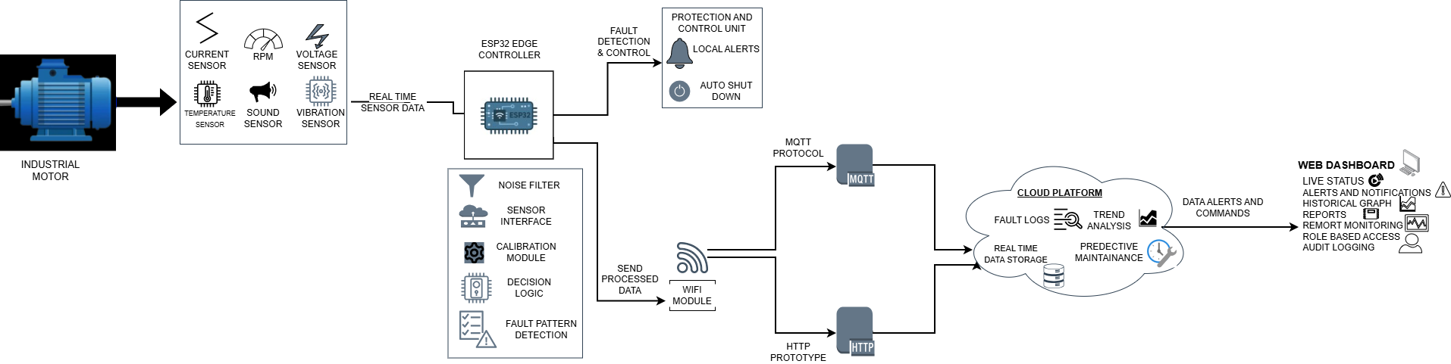
ARCHITECTURE
Proposed Architecture:
5

Slide 6
FEASIBILITY AND VIABILITY
Feasibility analysis of the proposed idea:
Strategies and action plans to overcome these challenges:
Uses low-cost, easily available hardware (ESP32 with standard sensors)
Relies on proven, industry-standard protocols (MQTT, HTTP) and open-source platforms
Real-time data processing comfortably handled by ESP32 (algorithm latency < 100 ms)
Non-intrusive design allows easy integration with existing motors
Scalable architecture suitable for single or multiple motor setups
Challenge / Risk | What we do (Mitigation) | Effect / Impact
Sensor noise or wrong readings | Calibrate sensors regularly, use simple filters to smooth data | Readings become more accurate and stable
Hot, noisy, vibrating factory environment | Put sensors and ESP32 in a strong box, fix them firmly, add grounding/shielding | Hardware lasts longer, fewer failures
Weak or unstable WiFi / internet | Take all safety decisions locally on ESP32, store data and resend when WiFi is back | System keeps working even if network fails
Too many false alarms or missed faults | Test on real motors, slowly adjust limits, use values suggested by standards | Fewer wrong alarms, more trusted alerts
Sudden power cuts or voltage dips | Use good power supply, surge protection, brown‑out detection and safe restart | Avoids random resets and data loss
Identification of potential challenges and risks:
Sensor noise, drift, and calibration errors may reduce measurement accuracy
Harsh industrial conditions (heat, vibration, EMI) can affect sensor reliability
Unstable Wi-Fi/network may interrupt cloud data transmission
Risk of false positives or missed faults during early fault-learning phase
Requires periodic maintenance and recalibration for long-term accuracy
6

Slide 7
IMPACT AND BENEFITS
Expected impact on the target audience:
Environmental Benefits
Reduces energy wastage from inefficient motors.
Extends motor life, lowering material waste.
Supports sustainable, condition-based maintenance.
Operational & Technical Benefits
Enables real-time monitoring and early fault prediction.
Supports data-driven maintenance decisions.
Scales easily across motors and industries.
Technical & System Impact
Detects faults before visible symptoms appear
Improves accuracy by correlating multiple sensor data
Reduces false alarms vs. single-sensor systems
Digital & Smart Factory Impact
Supports Industry 4.0 and smart manufacturing goals
Enables remote monitoring and centralized supervision
Lays foundation for future AI/ML-based diagnostics
Facilitates predictive analytics for proactive decision-making
(Industries & Maintenance Teams)
Fewer unexpected motor failures and breakdowns.
Shift from reactive to predictive maintenance.
Reduced downtime and higher production continuity.
Early fault detection preventing major equipment damage.
Improved worker safety and operational reliability.
Lower maintenance and spare-parts costs.
Reduced workload and stress on maintenance teams.
Better visibility into machine health and performance.
Key benefits of the solution :
Economic Benefits
Reduces unplanned downtime, increasing production uptime.
Prevents costly motor damage and replacements.
Delivers low-cost implementation with fast ROI.
Social / Workplace Benefits
Improves worker safety by preventing sudden failures.
Reduces maintenance stress through early alerts.
Minimizes emergency and night-shift repairs.
7

Slide 8
COMPARISON WITH EXISTING SYSTEM
  Comparison of proposed solution with existing solutions in tabular form:
Parameter | Existing Motor Monitoring Systems | Proposed Intelligent Monitoring System
Monitoring approach | Single-parameter or manual monitoring | Multi-sensor, correlated monitoring
Fault detection | After fault occurs (reactive) | Before failure (predictive)
Detection accuracy | Moderate, prone to false alarms | High accuracy using data correlation
Response time | Delayed, manual intervention | Real-time (<100 ms) automatic response
Maintenance type | Breakdown or time-based | Condition-based, predictive maintenance
Safety action | Alerts only | Alerts + automatic motor shutdown
Data access | Local indicators, no history | Cloud-based dashboard with data logs
Cost | High proprietary systems | Low cost (~₹5,000 per motor)
Scalability | Limited, complex expansion | Easily scalable across motors
Suitability | Large industries only | MSMEs and large industries
8

